Slide 1
CS2.201: Computer System Engineering-I
ICS231: Operating Systems
P.Krishna Reddy
E-mail: pkreddy@iiit.ac.in
http://www.iiit.ac.in/~pkreddy
Office: B3-205, Vindhya Building

Slide 2
Engineering of
Computer Operating Systems

Slide 3
Outline
Introduction
  What is an Operating System ?
Course topics and grading
History, development and concepts of Oss
Different kinds of Computer Systems
Concept of virtual computer

Slide 4
Questions
What is a system ?
What is an operating system ?
What is a computer operating system ?

Slide 5
What is a system ?
A system is an inter-related set of components with an identifiable boundary working together for some purpose.
System can be natural or fabricated
  Natural systems: human body or solar system
  Fabricated systems: cycle, bus, computer, government, boat

Slide 6
System
boundary
A system has nine characteristics
  Components
  Inter-related components
  A boundary
  A purpose
  An environment
  Interfaces
  Input
  Output
  Constraints.
input
interfaces
environment
Components
interfaces
Inter-realtionship
output
A general depiction of a system

Slide 7
Characteristics…
Components:
  A system is made up of components
  A component is either an irreducible part or aggregation of parts that make-up a system. A component is also called a sub-system.
Interrelated:
  The components of interrelated
  Dependence of one subsystem on one or more subsystems.

Slide 8
Characteristics…
Boundary (Scope):
  A system has a boundary, within which all of its components are contained and which establishes the limits of a separating the system from other systems.
Purpose
  The overall goal of function of a system. The system’s reason for existing.

Slide 9
Characteristics…
Environment
  Everything external to the system that interacts with the system.
Interface
  Point of contact where a system meets its environment or subsystems meet each other.
Constraint:
  A limit what a system can accomplish: Capacity, speed or capabilities.

Slide 10
Characteristics…
Input
  Whatever a system takes from its environment in order to fulfill its purpose.
Output:
  Whatever a system returns to its environment in order to fulfill its purpose.

Slide 11
Example: A fast food restaurant as a system
Output:
Prepared food,
Bank deposits,
Trash
Input:
Food, labor,
Cash, etc.
Storage
Office
Dining
room
Kitchen
Counter
Boundary
Environment: Customers, food distributors, banks etc
Represents an inter-relationship
Constraints: Popular foods, Health dept., constraints of storage

Slide 12
Important System Concepts
Decomposition
Modularity
Coupling
Cohesion

Slide 13
Decomposition
(Divide and Conquer)
  It deals with being able to break down a system into its components.
  Decomposition results in smaller and less complex pieces that are easier to understand than larger, complex pieces.
  Decomposing a system also allows to focus on one particular part of a system, making easier to think of how to modify that part independently of the entire system.

Slide 14
Modularity
Modularity refers to dividing a system up into chunks or modules of a relatively uniform size.
You can replace or add any other module (or a component) without effecting the rest of the system.
It is a design strategy in which system is composed of relatively small and autonomous routines fit together.

Slide 15
Coupling
Coupling is the extent to which subsystems are dependent on each other.
Subsystems should be as independent as possible.
If a subsystem fails and other subsystems are highly dependent on it, the others will either fail themselves or have problems in functioning.

Slide 16
Cohesion
The extent to which a system or a subsystem performs a single function.

Slide 17
What is an operating system ?
Operating system is a system.
Operating system is a subsystem of any tool.
Each tool constitutes machine part and operating part.
The operating part of a tool is called as operating system of that tool.
The purpose of operating system is to facilitate the operation of the underlying machine or tool.
For some tools, operating system may not exist.
  Example: Pen.
For a user, the operating system abstracts the machine part in terms of simple services by hiding the details of the machine. The OS can provide services to users or other subsystems.
Examples of typical operating systems:
  Car operating system, Telephone operating system, TV operating system and so on.

Slide 18
What is a computer operating system ?
A computer is also a tool that contains the machine part and the operating part.
The operating part of a computer is called Computer Operating System.
the operating system abstracts the underlying hardware in terms of simple services by hiding the details of the hardware. The OS can provide services to users or other subsystems.
Examples of Computer operating systems:
  WINDOWS 10, Macintosh, UNIX, SOLARIS, LINUX, Android, MAC IOS and so on.
In the rest of this course, operating system means computer operating system.

Slide 19
Computer System Components
1. Hardware – provides basic computing resources (CPU, memory, I/O devices).
2. Operating system – controls and coordinates the use of the hardware among the various application programs for the various users.
3. Applications programs – define the ways in which the system resources are used to solve the computing problems of the users (compilers, database systems, video games, business programs).
4. Users (people, machines, other computers).

Slide 20

Abstract View of System Components

Slide 21
What is an Operating System?...
A program that acts as an intermediary between a user of a computer and the computer hardware.
Operating system goals:
  Make the computer system convenient to use.
  Use the computer hardware in an efficient manner.

Slide 22
Operating System Definitions…
Resource allocator – manages and allocates resources.
  Resources: CPU time, Memory Space, file storage space, I/O devices and son on.
Control program – controls the execution of user programs and operations of I/O devices .
Kernel – the one program running at all times (all else being application programs).
The two goals, efficiency and convenience are sometimes contradictory
Much of OS theory is concentrates on optimal use of resources.

Slide 23
Outline
Introduction
  What is an Operating System ?
Course topics and grading
History, development and concepts of Oss
Different kinds of Computer Systems
Concept of virtual computer

Slide 24
Objectives
Understand the operational part of any computer.
  introduce a framework of engineering/computer system design
  discuss important design ideas which have been evolved for building modern operating systems and (
  study how these design ideas have been extended to build the components of modern operating systems.
Understanding the general principles of OS design.
  Focus on general-purpose, multi-user systems.
  Emphasis on widely applicable concepts rather than any specific features of any specific OS.
Understanding problems, solutions and design choices.
Understanding the structure of specific OSs: UNIX, LINUX, WINDOWS 10

Slide 25
Course topics
Introduction (1 week);
Thinking about systems (1 week);
Process Management (2 weeks);
CPU Scheduling (1 week),
Process Synchronization (2 weeks);
Deadlocks (1 week);
Memory management (1.5 weeks),
Virtual Memory (1.5 weeks),
File Systems (1 week);
Protection and Security (1 week);
Other topics (1 week).

Slide 26
References
Text book:
  Silberschatz, A, Galvin, P, Gagne, G. Operating System Concepts, Addison-Wesley (8th or latest edition).
  Saltzer, Jerome H. and M. Frans Kaashoek. Principles of Computer System Design: An Introduction, Part I. Morgan Kaufmann, 2009.
Other Reference BOOKS:
  William Stallings, Operating systems, Prentice-Hall, 1998.
  Operating Systems, Gary Nutt, Pearson Education
  Charles Crowley, Operating Systems: A design-oriented approach, Tata McGraw-Hill, 1997.
  Operating Systems: Concepts and Design, Milan Milenkovic, TATA McGRAW-HILL
  Tanenbaum, A., Modern Operating Systems, Prentice-Hall, second edition, 2000.

Slide 27
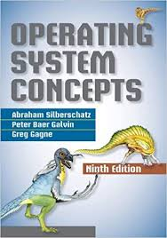

Slide 28
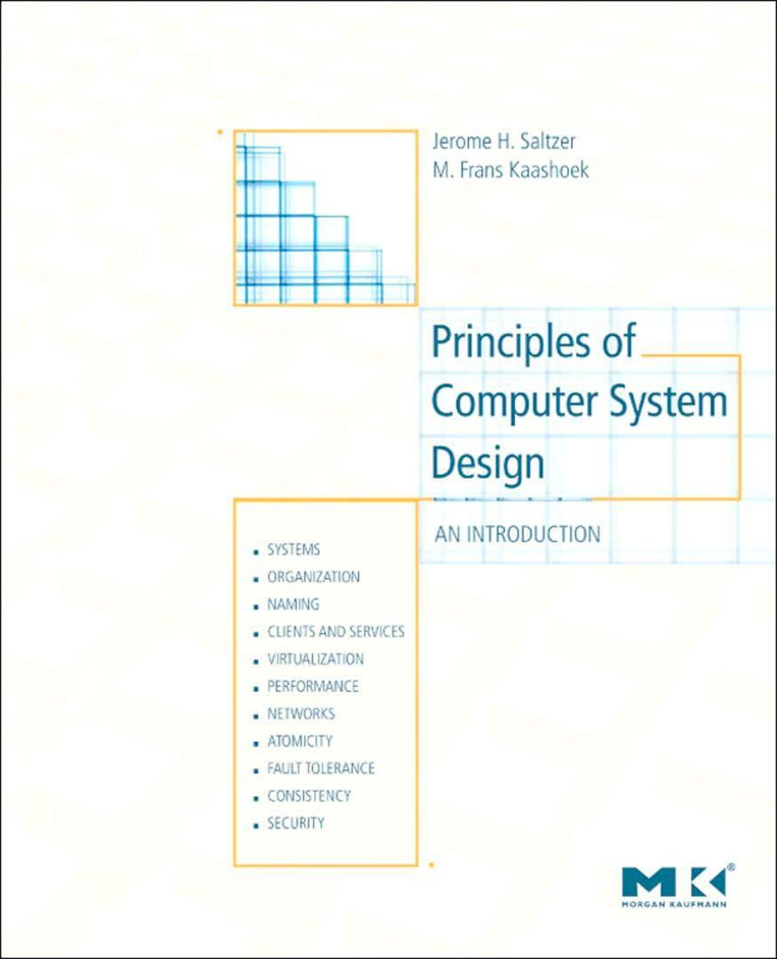

Slide 29
LAB WORK
Experiments will be on the exposing the working of several system calls of LINUX OS:
  Installation
  reversing a file
  Shell writing
  Process communication
  Bounded buffer,
  semaphores,
  shared memory,
  threads;
  Replace "ls" with lookup;
  Command line for /proc;
  Memory management
The lab is very intensive. Please do not ask for the extension of deadline. Each experiment will be evaluated.

Slide 30
Related Research Papers
H. M. Levy and P. H. Lipman. Virtual Memory Management in the VAX/VMS Operating Systems. IEEE Computer, 15(3), March 1982, pp. 35-41.
Thompson, K., "UNIX Implementation," The Bell System Technical Journal, Vol. 57, No. 6 (July-August 1978), Part 2, pp. 1931-1946.
F. J. Corbato and V. A. Vyssotsky, "Introduction and overview of the Multics system," In Proceedings AFIPS 1965 Fall Joint Computer Conference (FJCC), Vol. 27, No. 1, 1965, Spartan Books: New York, pp. 185-196
Windows NT and VMS: The Rest of the Story, by Mark Russinovic
E. W. Dijkstra, "The Structure of the THE ##Multiprogramming System," Communications of the ACM, Vol. 11, No. 5, May 1968, pp. 341-346
C. Daley and J. B. Dennis. Virtual Memory, Processes, and Sharing in MULTICS. Communications of the ACM, 11(5), May 1968, pp. 306-312.
Ritchie, D.M., and Thompson, K., "The UNIX Time-Sharing System,"The Bell System Technical Journal, Vol. 57, No. 6 (July-August 1978), Part 2, pp. 1905-1929.

Slide 31
Reading/Practicing Assignments
Problems will be given
You have to solve on your own

Slide 32
OUTCOME
After completing the course, the students will understand
  key design ideas evolved since 1950 for building general systems and computer systems,
  the fundamental concepts of several computer operating systems such as SOLARIS, LINUX, WINDOWS and MAC.
  the solutions/options to interesting problems which have been encountered by the designers of preceding operating systems.
  the critical role of operation system in designing several computer based systems like database systems, expert systems, web based information systems, real-time systems, embedded systems and so on.

Slide 33
GRADING
Quiz I: 7 %
MIDTERM : 20 %
Quiz2: 8%
ENDSEM EXAM: 35 %
LAB: 30 %

Slide 34
Outline
Introduction
  What is an Operating System ?
Course topics and grading
History, development and concepts of Oss
Different kinds of Computer Systems
Concept of virtual computer

Slide 35
Stored Program Computer
1940
  Computers were designed to perform specific tasks.
  Modification of the tasks required a great deal of effort and manual labour
Alan Turing and John von Neumann
  Proposed the concept of stored program computer.
  Machine has both program store and data store and program store provides instructions about what to do on data.
  This concept has generated the concept of general purpose computer.
Watch the movie
  The Imitation Game
1951
  First general purpose computer
    Machester Mark 1 (ran duriing 1940 to 1949)
  First general purpose commercial computer was available in the market
    Ferranti Mark1

Slide 36
Early systems (Serial processing)
1940-50:
  The programmer interacted directly with the computer hardware.
  Display light, switches, printer, card reader.
  No OS.
  Error is displayed through lights.
Problems:
  Scheduling → Users spend lots of time at the computer.
    Signup sheet was used.
  Job Setup time
    Loading and compiling
      Mounting and Un-mounting of tapes
      Setting up of card desks
  Libraries of functions, linkers, loaders, debuggers, and I/O driver routines were available for all the users.

Slide 37
Early Systems…
Early computers were (physically) large machines run from a console.
The programmer would operate the program directly from the console.
  The program is loaded to the memory from panel of switches, paper tape, and from punched cards.
As time went on, additional software and hardware were developed.
  Card readers, line printers, and magnetic tape became common place.
  Libraries, loaders, and common functions were created.
    Software reusability.

Slide 38
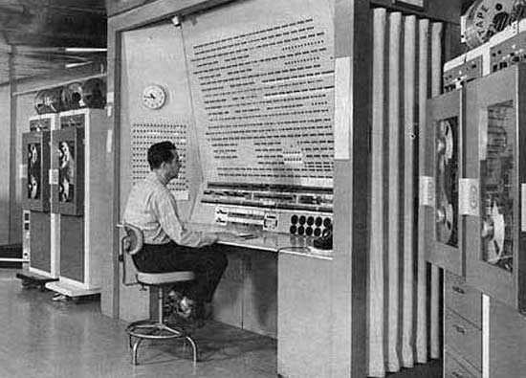

Slide 39
Early Systems…
The routines that performed I/O were especially became important.
Device driver: A special subroutine was written for each I/O device.
  A device driver knows how the buffers, flags, registers, control bits, and status bits for a particular device should be used.
  Device driver is written once and called from the library.
Later, compilers for FORTRAN, COBOL and other languages have appeared.

Slide 40
Early Systems…
Significant amount of setup time.
Each job consisted of many separate steps:
  Loading the FORTRAN compiler tape
  Running the compiler
  Unloading the compiler tape
  Loading of assembler tape
  Running assembler
  Unloading the assemble tape
  Loading the object program
  Running the object program
If error occurred during any step, you have to start over at the beginning.

Slide 41
Early Systems..
The setup time was a real problem
CPU is idle while tapes are being mounted or the programmer was operating the console.
In the early days, few computers were available and they were expensive (millions of dollars).
  +operational costs: power, cooling, programmers.
Main question:
How to increase the utilization of CPU ?

Slide 42
Early Systems…
The solution was two fold.
First, a professional computer operator was hired.
  Once the program was finished, he operator could start next job.
  The operator sets up the job, produces the dump, and starts the next job.
  The set up time was reduced due to operator’s experience.
Second, jobs with similar needs were batched together and run through the computer as a group.
  For example, if there is a FORTRAN job, COBOL job, and FORTRAN job, two FORTRAN jobs were batched together.
However, during transition time CPU sat idle.
To overcome this idle time, people developed automatic job sequencing.
  A first rudimentary OS was created
  A small program called a resident monitor was developed.
  The resident monitor always resided in memory.

Slide 43
Simple Batch Systems ( early 1960s)
In serial systems
  Machines were very expensive
  Wasting time was not acceptable.
To improve usage, the concept of batch OS was developed.
The main idea is the use of software known as monitor.
  The user no longer has access to machine.
The user submits the job (tape) to the operator.
The operator batches the jobs together sequentially, places entire batch as an input device for use by the computer.

Slide 44
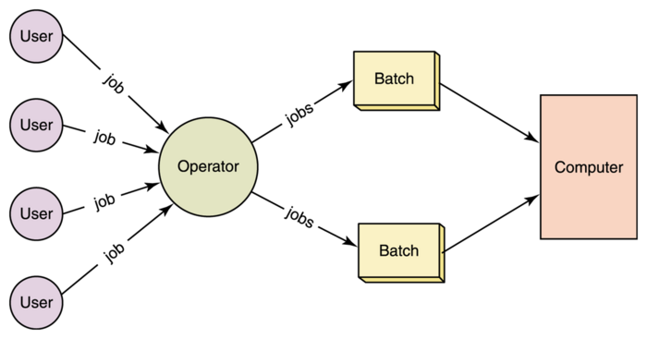

Slide 45
Memory Layout for a Simple Batch System
Interrupt procedures
Device drivers
Monitor
Job sequencing
Command language
interpreter
Boundary
User program
area
Resident monitor

Slide 46
Simple Batch Systems..
At the beginning of any job, the corresponding subroutines and functions are loaded.
The monitor reads the jobs one at a time from the input device.
Algorithm for monitor:
  The control is passed to the user’s program.
    Processor is fetching and executing user’s instructions.
  After completion, the control is returned to the monitor program
    Processor is fetching and executing monitor instructions.

Slide 47
Features of Batch System
The batch OS is simply a program.
It relies on the ability of the processor to fetch instructions from various portions of main memory to seize and relinquish control.
Hardware features:
  Memory protection: While the user program is running, it must not alter the memory area containing the monitor.
    If such is the case the processor hardware should detect the error and transfer control to monitor.
  Timer: A timer is used to prevent the single job from monopolizing the system
  Privileged instructions
    Contains instructions that are only executed by monitor.
    I/O instructions
    If a program encounters them the control shifts through monitor..
  Interrupts: It gives OS more flexibility.
    Relinquishing control and regain control

Slide 48
Features of Batch System
With batch OS, the machine time alters between execution of user programs and execution of monitor.
Two overheads
  Machine time is consumed by the monitor.
  Memory is consumed by the monitor.
Still, they improved the performance over serial systems.

Slide 49
Problems with the Batch System
CPU is idle
Speed of mechanical devices is very slower than those of electronic devices.
CPU works in a microsecond range
  Thousands of instructions/second
A card reader may read 1200 cards per minute (20 cards per second)
CPU speed has increased at a faster rate.
Tape technology improved the performance little-bit.
Main perceived problem
  Turn-around time: upto two days
  CPU often underutilized
    Most of the time was spent reading and writing from tape.

Slide 50
Resident monitor: summary
Automatic job sequencing
  Use of control cards
Job control language
  Commands
    Mount this tape
    Compile
    Run
OSs begin to be important.
  IBM: Fortran monitor system
Main perceived problems
  Turn-around time
  Inexpensive use of expensive hardware
  CPU is still mostly idle.

Slide 51
Spooling
The introduction of disk technology helped in this regard.
Disk technology introduced the SPOOLing (Simultaneous Peripheral Operations On-Line)
Considers disk as a huge buffer.
Input comes from the disk
Output goes to the disk.
DISK
Card
Reader
Line
Printer
CPU

Slide 52
Advantage of Spooling
Reading can be done in advance.
Output can be stored on the disk.
Spooling is also used for processing data at remote sites.
Spooling overlaps the I/O of one job and computation of other jobs.
Even printing and reading can overlap.
Spooling can keep both the CPU and the I/O devices working at higher rates.
Disk is a random access device.

Slide 53

Multi-programmed Batched Systems
(1960s) (or Multi tasking)
A single user can not keep either CPU or I/O busy.
Multiprogramming increases CPU utilization by organizing jobs such that the CPU always has one to execute.
The OS keeps several jobs in memory at a time and CPU is multiplexed among them

Slide 54
Multi-programmed Batch Systems
If CPU is executing a job and requires a tape to be mounted
  In a non multi-programmed system
    CPU sits idle.
  In a Multi-programmed system
    CPU takes up another job.
Multiprogramming is the first instance when the OS started taking decisions.
Job scheduling is done by OS.
Having several programs in the memory requires memory management.

Slide 55
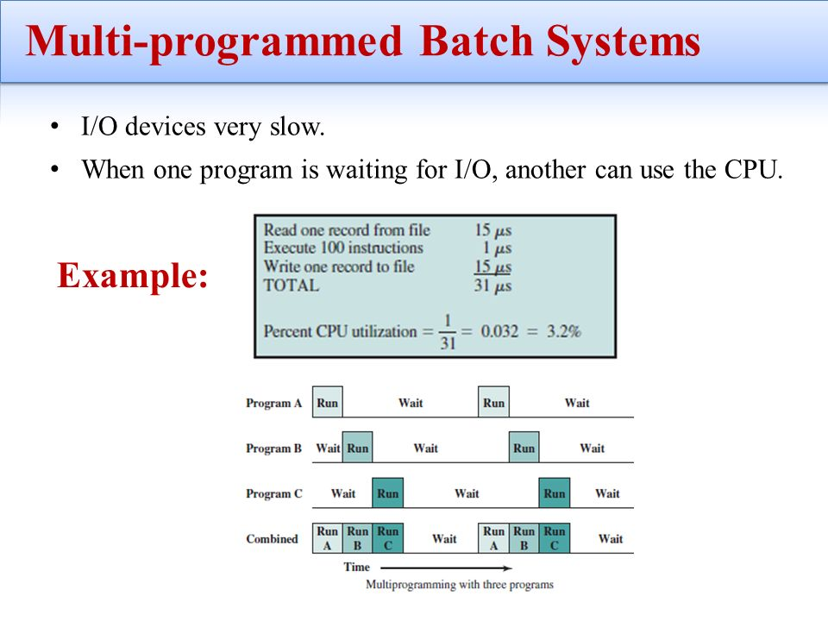

Slide 56
OS Features Needed for Multiprogramming
I/O routine supplied by the system.
Memory management – the system must allocate the memory to several jobs.
CPU scheduling – the system must choose among several jobs ready to run.
Allocation of devices.

Slide 57
Time-Sharing Systems–Interactive Computing
With multiprogramming
  Utilization is OK
  Response time was a problem.
Timesharing:
  Programs could interact with user.
Programs
  Could wait for I/O for arbitrary time
    CPU switched to another job.
    However, resident jobs took up valuable memory
      Needed to be swapped out to disk
      Virtual memory.
Time-sharing systems were developed to provide interactive use of a computer system at a reasonable cost.

Slide 58
Time-Sharing Systems–Interactive Computing
A time sharing system uses CPU scheduling and multi-programming to provide each user with a small portion of a time shared computer.
A program that is loaded into a memory and is executing is commonly known as a process.
In timesharing system, a process executes for only a short time.
  I/O is at people speeds, but OS can switch rapidly.
A time-shared OS system allows the many users to share the computer simultaneously.
It gives the impression that the user has own computer, whereas actually a computer is shared among many users.

Slide 59
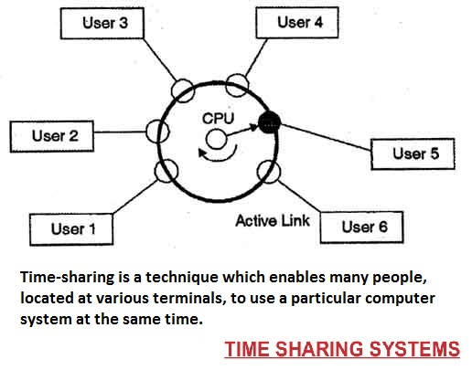

Slide 60
About Modern OSs
Multiprogramming and timesharing are the central themes of modern OSs.
Multiprogramming and timesharing requires
  CPU scheduling
  Process synchronization and communication
  Deadlock detection
  Memory management and protection
  Virtual memory: A program is bigger than physical memory
  Online file systems.
  Disk management
  Security and protection
  Real-time and multimedia support
In this course, we will discuss key concepts/algorithms /ideas developed since 1950 on the preceding aspects/issues.

